Slide 1


Theodore Roosevelt Expressway
Annual Meeting
Watford City, November 26, 2013
Plenty to Do…
Amid Growing Opportunities
Joe Kiely
Vice President of Operations
Ports-to-Plains Alliance

Slide 2


Slide 3
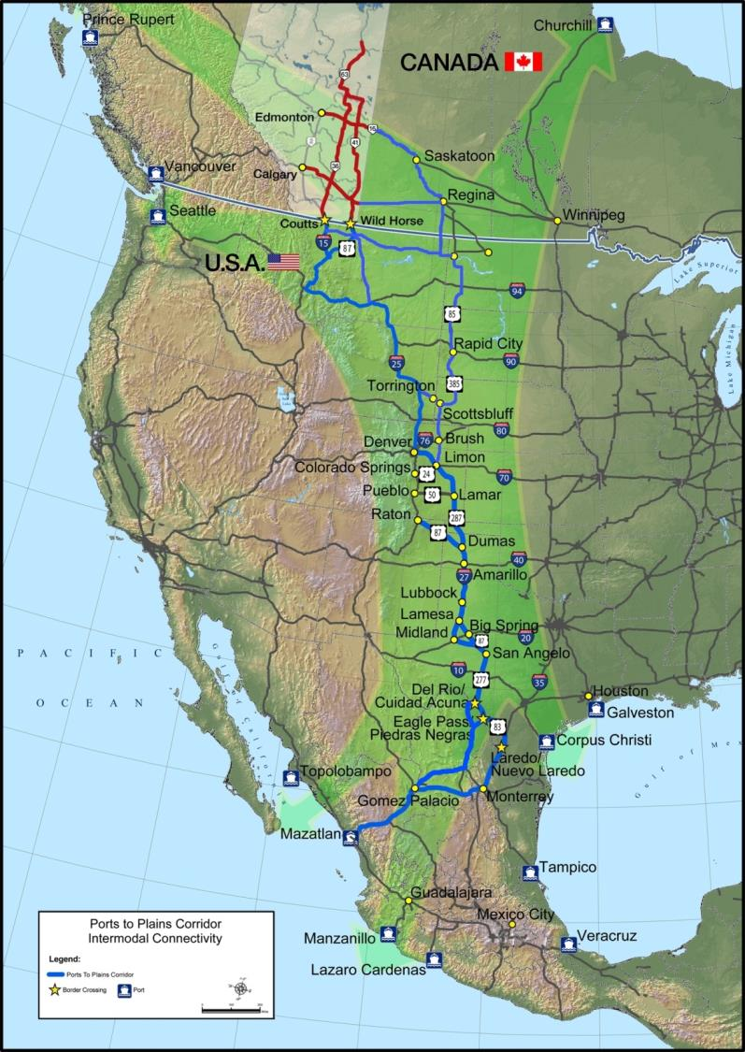

Securing the Benefits of Commerce to North America’s Energy & Agricultural Heartland
Mission:
Ports-to-Plains is a grassroots alliance of communities and businesses whose mission is to advocate for a robust transportation infrastructure to promote economic security and prosperity throughout North America's energy and agricultural heartland.

Slide 4
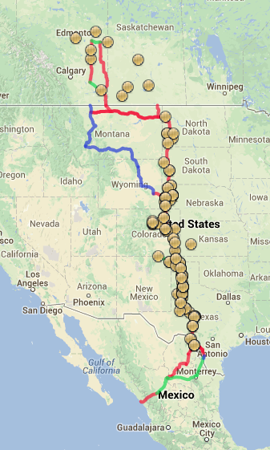
Membership:
Government of Alberta
Alliances:
  Theodore Roosevelt Expressway
  Heartland Expressway
Municipalities
Counties
Economic Development
Chambers of Commerce
Businesses
172 current members in U.S. and Canada. Expanding into Mexico.

Slide 5

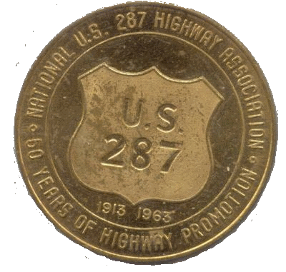

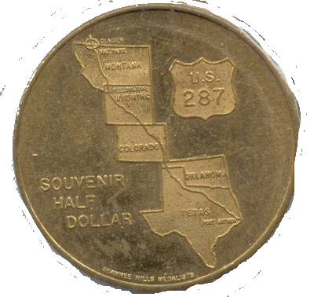

Slide 6
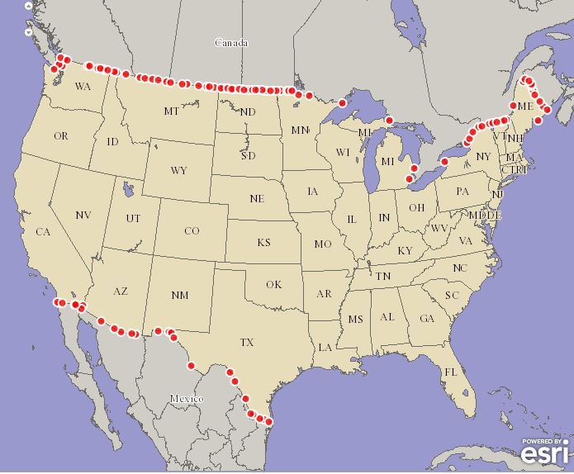
Corridor Growth Projections – North Dakota Truck Exports 2002-2040
Corridor Growth Projections – South Dakota Truck Exports 2002-2040
Corridor Growth Projections – Montana
Truck Exports 2002-2040

Slide 7
Corridor Growth Projections – North Dakota Truck Exports 2002-2040
US – 282%
PTP - 761%
NA – 795%
U.S. Department of Transportation, Federal Highway Administration, Office of Freight Management and Operations, Freight Analysis Framework (FAF³)

Slide 8
Corridor Growth Projections – South Dakota Truck Exports 2002-2040
US – 214%
PTP - 770%
NA – 754%
U.S. Department of Transportation, Federal Highway Administration, Office of Freight Management and Operations, Freight Analysis Framework (FAF³)

Slide 9
Corridor Growth Projections – Montana
Truck Exports 2002-2040
US – 136%
PTP - 69%
NA – 96%
U.S. Department of Transportation, Federal Highway Administration, Office of Freight Management and Operations, Freight Analysis Framework (FAF³)

Slide 10
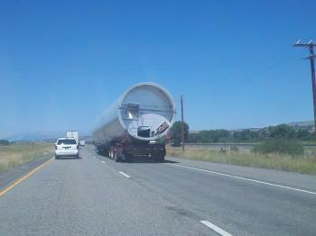
Federal Transportation – MAP-21
Freight Advisory Committee and State Freight Plan
  Interim Guidance: October 15, 2012
    The Department also strongly encourages all States to establish State Freight Advisory Committees. Such Advisory Committees are an important part of the process needed to develop a thorough State Freight Plan. Bringing together the perspectives and knowledge of public and private partners, including shippers, carriers, and infrastructure owners and operators, is important to developing a quality State Freight Plan.

Slide 11
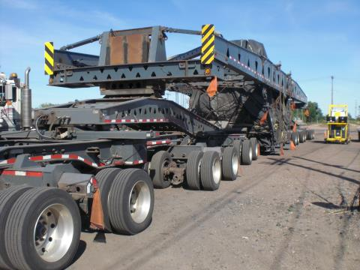
Federal Transportation – MAP-21
Freight Advisory Committee and State Freight Plan
  Status of Freight Advisory Committees
    North Dakota
      No Freight Advisory Committee
      State Rail Plan in Place
      North Dakota Strategic Freight Planning Analysis -Phase II: 2006-2008
      Statewide Strategic Transportation Plan
    South Dakota
      No Freight Advisory Committee
      State Rail Plan in Process
      Statewide Long Range Transportation Plan
      No State Freight Plan

Slide 12
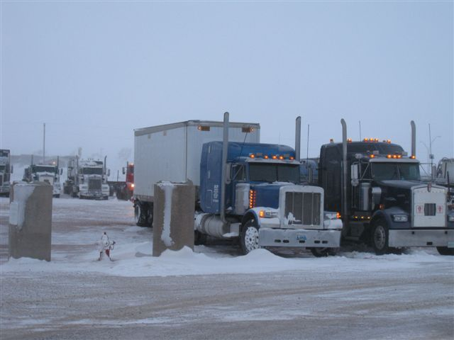
Federal Transportation – MAP-21
Freight Advisory Committee and State Freight Plan
  Status of Freight Advisory Committees
    Montana
      No Freight Advisory Committee
      Department of Transportation Director Mike Tooley serves on National Freight Advisory Committee
      State Rail Plan in Place
      No State Freight Plan

Slide 13
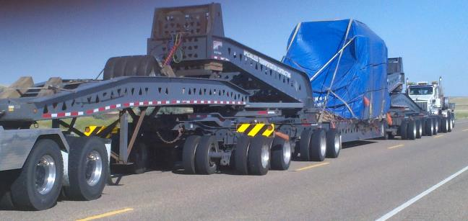
Federal Transportation – MAP-21
Freight Advisory Committee and State Freight Plan
  Suggested Action Items
    Encourage State DOTs to develop State Freight Advisory Committees per MAP-21
    Encourage development of a State Freight Plan per MAP-21

Slide 14
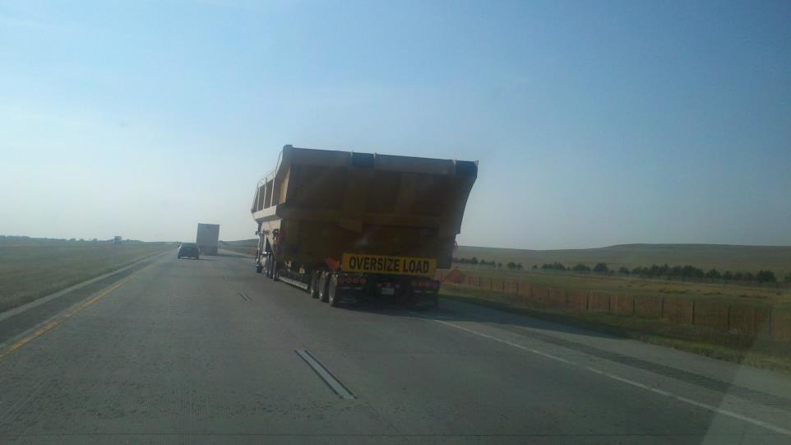
Federal Transportation – MAP-21
Primary Freight Network (PFN)
  Guidance: November 19, 2013
    DOT seeks comments on the routes identified in the draft initial highway PFN of 26,966 miles, including the specific identification of roadways that freight partners and stakeholders believe should be included or removed.

Slide 15
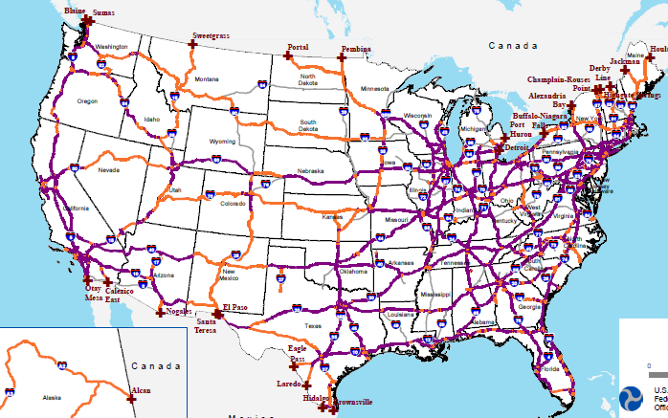
Federal Transportation – MAP-21
Primary Freight Network (PFN) – United States

Slide 16
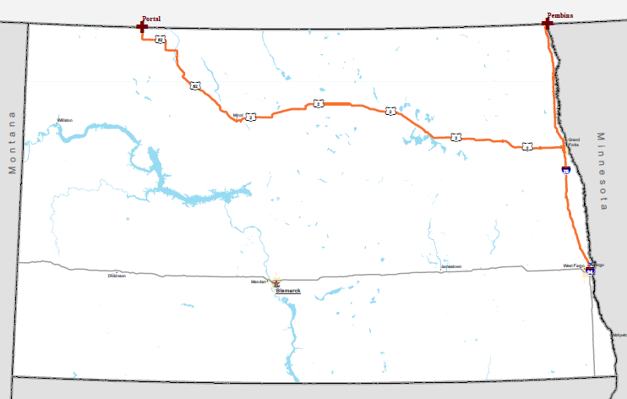
Federal Transportation – MAP-21
Primary Freight Network (PFN) – North Dakota

Slide 17
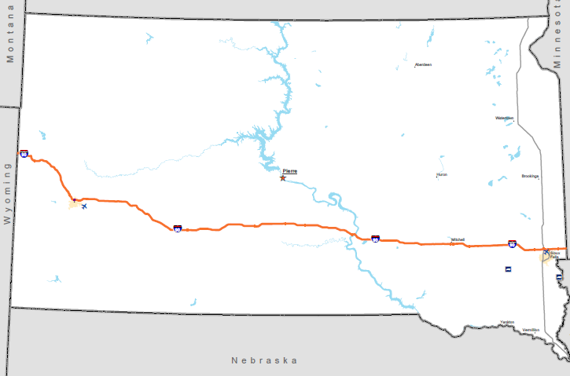
Federal Transportation – MAP-21
Primary Freight Network (PFN) – South Dakota

Slide 18
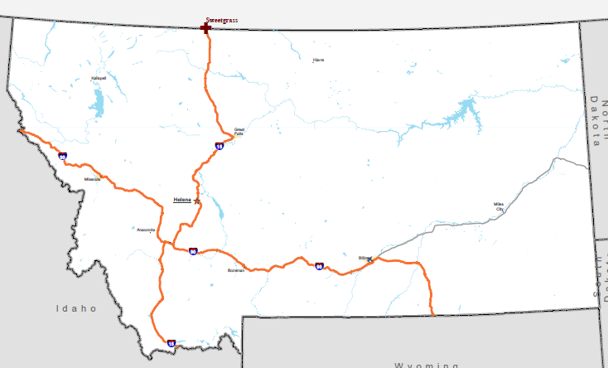
Federal Transportation – MAP-21
Primary Freight Network (PFN) - Montana

Slide 19
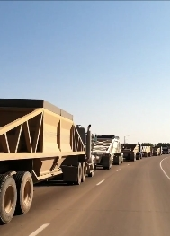
Federal Transportation – MAP-21
Primary Freight Network (PFN)
    Suggested Action Items
      Determine DOT response to 27K PFN and support that Response

Slide 20
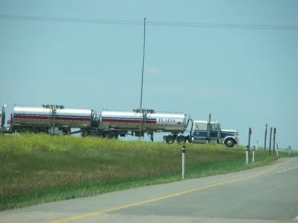
Federal Transportation – MAP-21
Critical Rural Freight Corridors (CRFC)
  Guidance: November 19, 2013
    MAP-21 provides that a State may designate a road within the borders of the State as a CRFC if the road is a rural principal arterial roadway, and:
    has at least 25 percent of the AADTT of the road measured in passenger vehicle equivalent units from trucks (FHWA vehicle class 8 to 13); or
    provides access to energy exploration, development, installation or production areas; or
    connects the highway PFN, a roadway described above, or the Interstate System to facilities that handle more than 50,000 20-foot equivalent units per year, or 500,000 tons per year of bulk commodities.

Slide 21
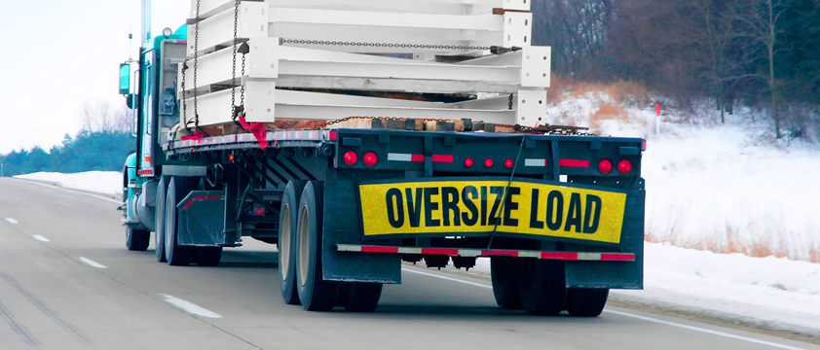
Federal Transportation – MAP-21
Critical Rural Freight Corridors (CRFC)
  Suggested Action Items
    Urge State DOTs to establish CRFC per MAP-21
    Entire TRE from the Rapid City, SD to Montana/Canada border should be identified as a Critical Rural Freight Corridor.

Slide 22
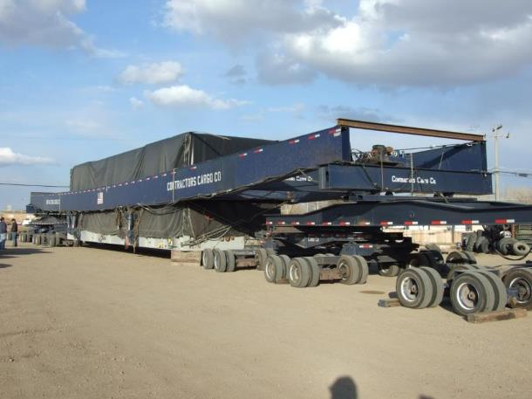
Federal Transportation – MAP-21
Critical Rural Freight Corridors (CRFC)
  Suggested Action Items
    Corridor meets criteria as rural principal arterial roadway
    Corridor provides access to energy exploration, development, installation or production areas.

Slide 23
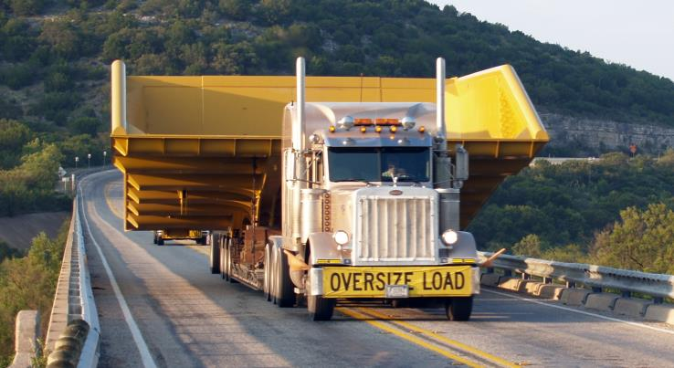
Federal Transportation – MAP-21
Critical Rural Freight Corridors (CRFC)
  Suggested Action Items
    The role of the TRE in the Ports-to-Plains Alliance Corridor; that connects to energy exploration, development, installation or production areas in the Bakken, Niobrara, Permian and Eagle Ford plays, makes it a Critical Rural Freight Corridor.

Slide 24
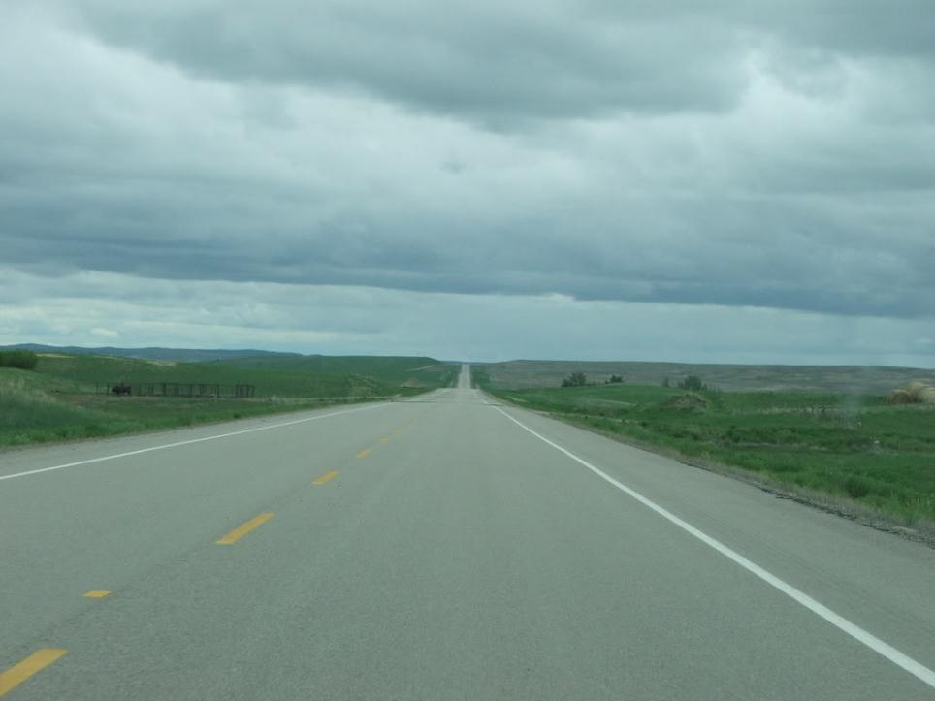





Joe Kiely
Vice President of Operations
P.O. Box 9
Limon, CO 80828
P: 719-775-2346
C: 719-740-2240
joe.kiely@portstoplains.com
www.portstoplains.com
www.ptpblog.com

