Slide 1
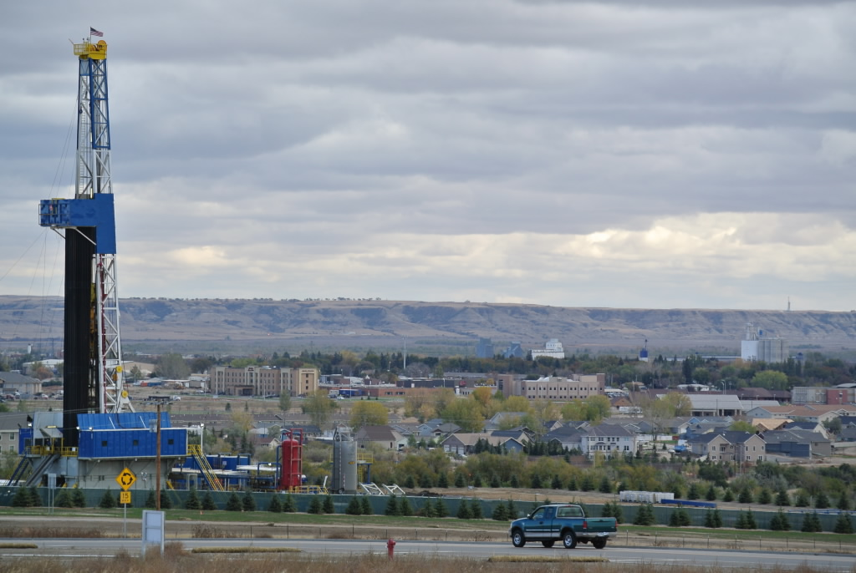
The Bakken Boom –
Transportation Impacts
Rory Nelson
ND Energy Impact Coordinator

Slide 2
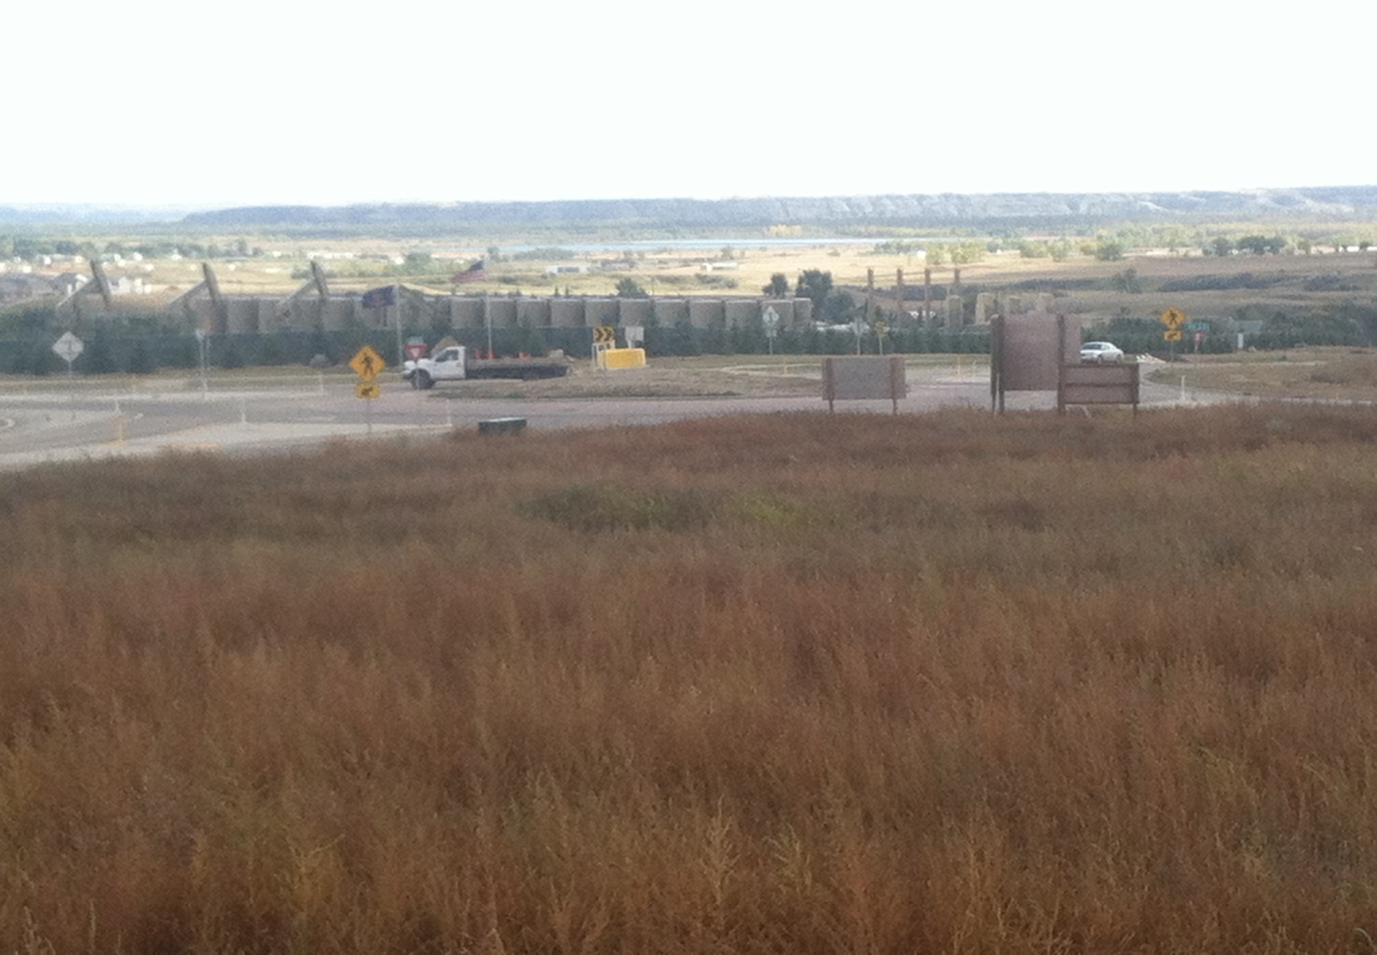

Slide 3
93% ND Production is Bakken

Slide 4
North Dakota
Bakken
Bakken Mature Area
Bakken Production
15,000 sq. miles
(size of West Virginia)
8,000 wells
1 Horizon/1,280 acres
Three Forks

Slide 5
North Dakota

Slide 6
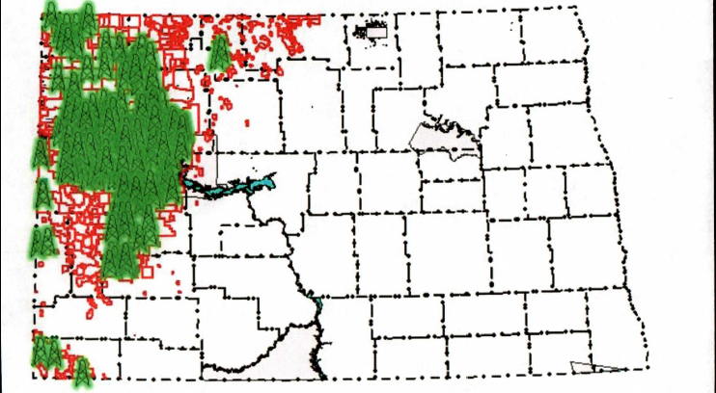
North Dakota
North Dakota – 183 Drilling Rigs – September 2013
Current Drilling Activity is Focused in McKenzie, Mountrail, Williams, & Dunn Counties

Slide 7
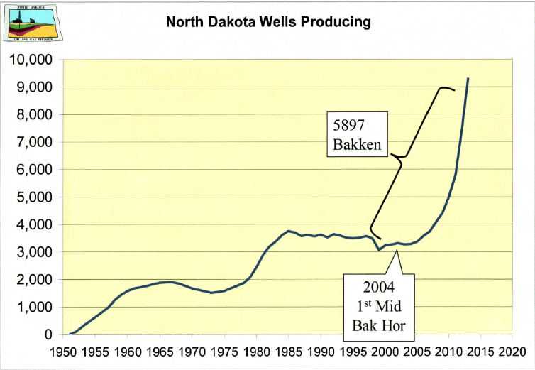
North Dakota
5,889 Bakken
9,682 Total Wells: 60.8% Bakken

Slide 8
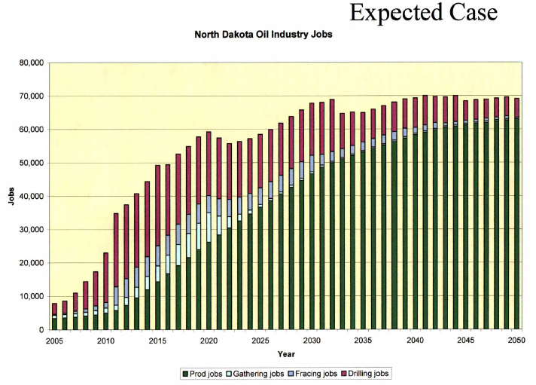
North Dakota

Slide 9
Impacts:
Roads
Water
Land Use
Structures, Traffic, Aggressive Drivers, Dust
Available Fresh Water, Sewage Systems
Planning & Zoning Issues, Housing, EMS Services, Law Enforcement, Schools, etc.
Other
Social Services, Health Professionals, etc.

Slide 10
Possible Transportation Solutions:
Oil “road corridors”
Pipelines for fluid movements
Truck route by-pass for cities
Time

