Slide 1
TRE Annual meeting
Grant Levi, NDDOT Director
November 26, 2013

Slide 2
Overview
Federal Funding
State Funding
US 85 Projects
Truck Bypasses
Traffic Data
Future Work
Safety

Slide 3
Federal Funding
MAP 21 is a two-year bill signed into law in 2012.
Bill expires September 30, 2014.
The bill states North Dakota has an apportionment of:
$240.5 million in 2012 and 2013.
$242.5 million in 2014.
Received $241.2 million in obligational authority for 2013.
$62.8 million in obligational authority thru January 15 for fiscal year 2014.

Slide 4
Uncertainty of Federal Funding

Slide 5
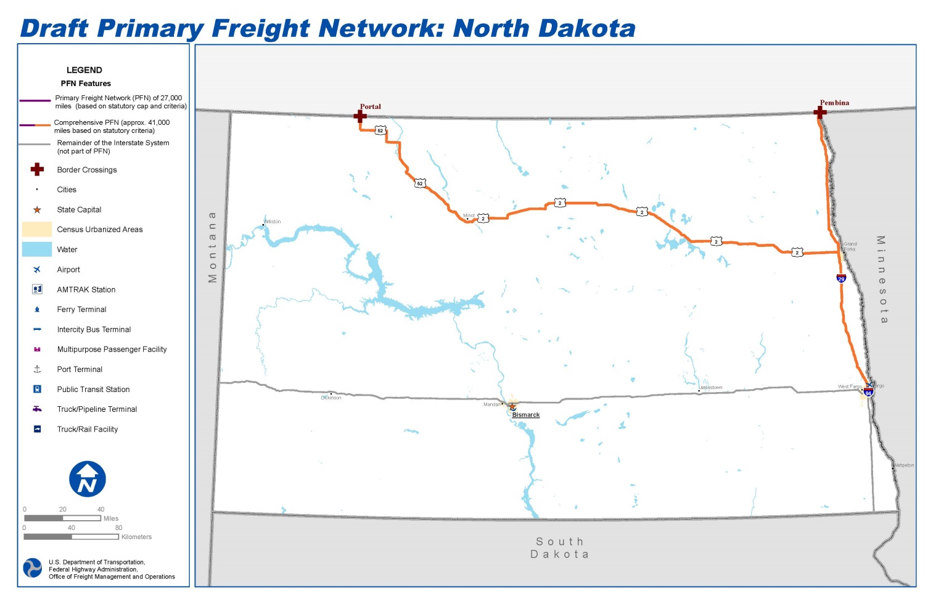
Freight Study
US DOT has identified proposed freight corridors in North Dakota. Can submit comments to US DOT by January 17, 2014. To submit comments, contact Ed Strocko, FHWA Office of Freight Management and Operations, (202) 366–2997, or by email at Ed.Strocko@dot.gov.

Slide 6
State Funding
NDDOT Funding for 2013-15 Biennium
Approximately $2.3 billion was appropriated to rebuild and repair state highways, city, county and township roads, bypass routes, bridges and other infrastructure upgrades in every region of the state.
NDDOT has obligated the majority of those funds through our STIP process.

Slide 7
Transportation Funding
State & Federal Funding
NDDOT Funding for 2013 – 2015 BIENNIUM (SB 2012, SB 2176, HB 1358)

Slide 8
Historic Construction Program
Working with our partners – county, city, township and tribal agencies - the Department will deliver the largest road construction program in state history, over $878 million in projects during 2013.
$878 M
$590 M
$550 M
$410 M
$275 M
$319 M
$249 M

Slide 9
2013 Construction Projects

Slide 10
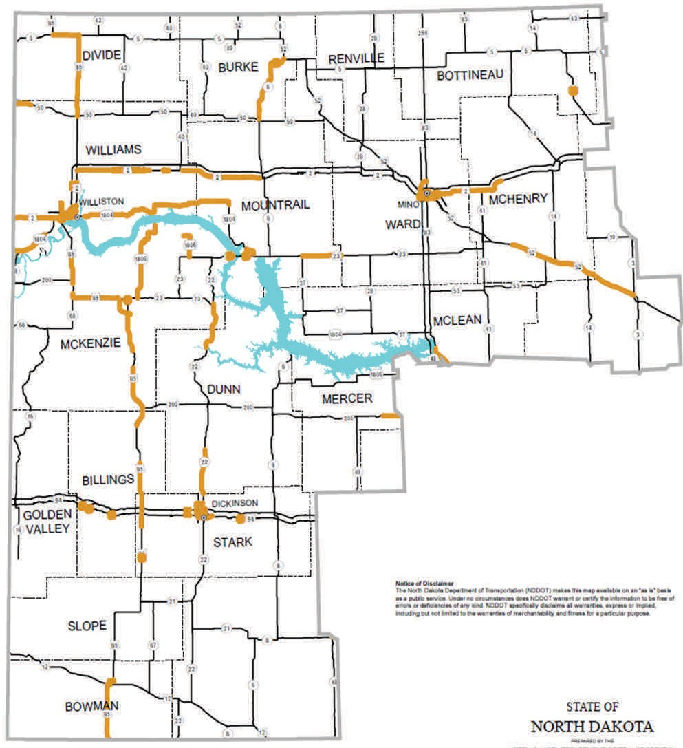
2013 projects in oil impact areas

Slide 11
County Funding
NDDOT allocated funds through our STIP process.
Total Cost of Projects
Counties | Total Cost of Projects Submitted | Total Cost of Projects Moving Forward | 90% of Total Cost | State funds Allocated
Oil Producing | $ 344,523,725 | $ 208,270,350 | $187,443,315 | $ 160,000,000
Non-oil Producing | $ 242,157,418 | $ 177,289,039 | $ 159,560,135 | $ 120,000,000
Total | $ 586,681,143 | $ 385,559,389 | $ 347,003,450 | $ 280,000,000

Slide 12
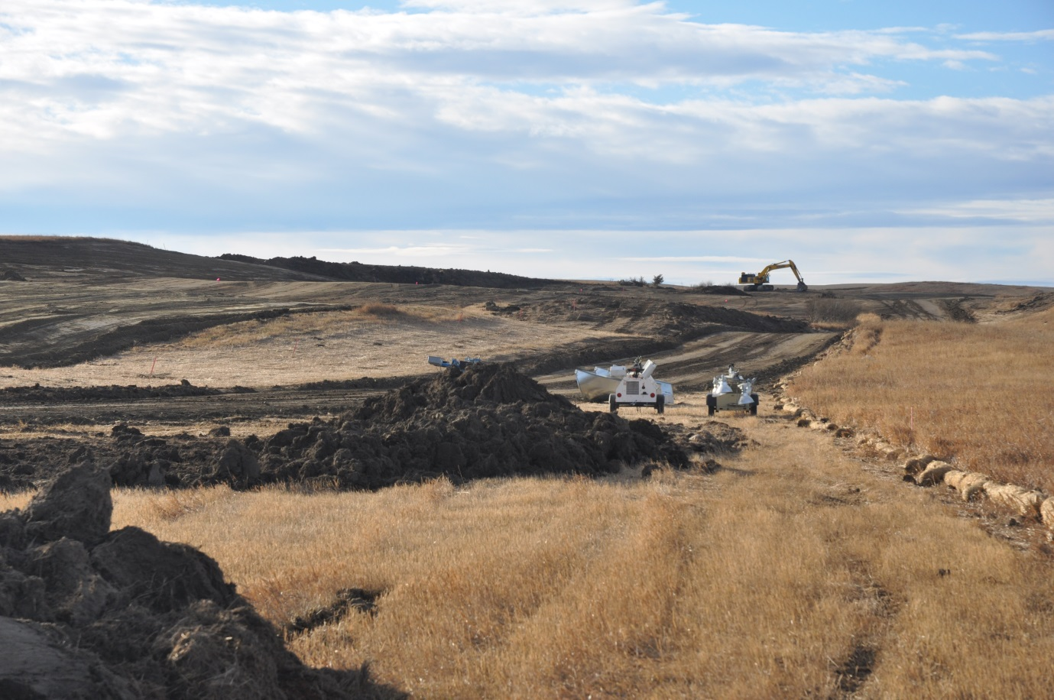
US Highway 85 Investment
Investing approximately $465 million in projects on the US 85 corridor in 2013 and 2014.
Watford City Bypass

Slide 13
US 85 between Watford City and Williston
Divided Four-Lane Design
Safety features include:
Large rumble strips across median area.
Edgeline rumble strips.
Left and right turn lanes at various access points - remove vehicles from traffic flow.

Slide 14
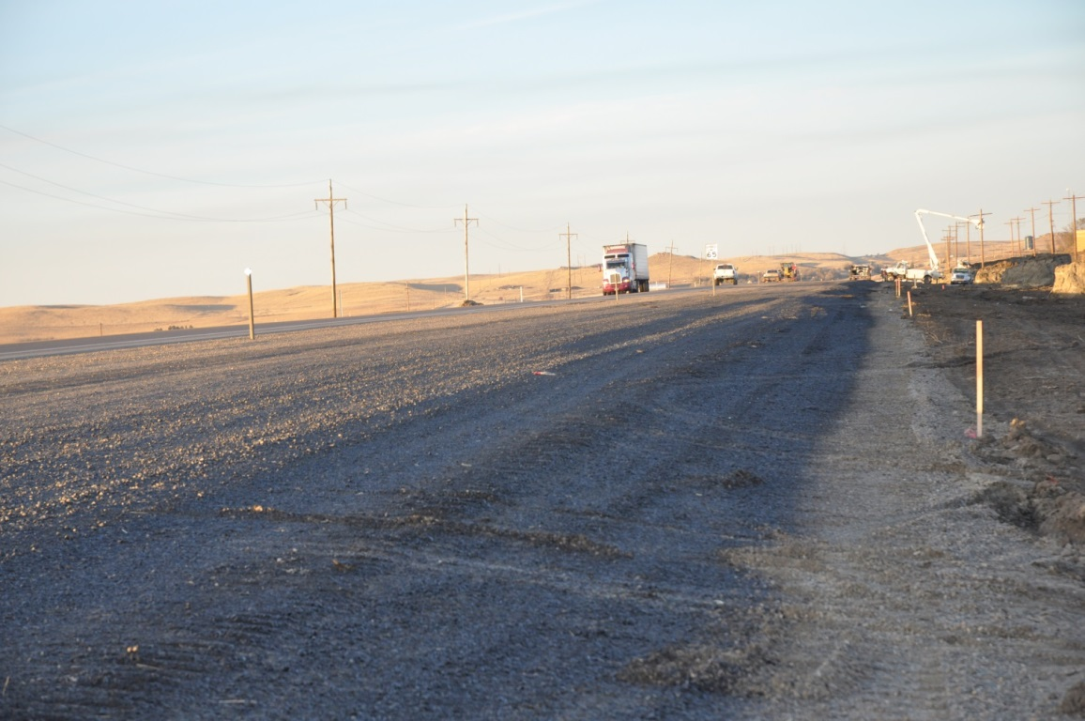
US 85 Construction Progress
NDDOT progress on US 85, four lane between Watford City and Williston
Watford City to County Road 16
County Road 16 to Williston- still waiting on environmental document from FHWA.
US Highway 85 west of Watford City

Slide 15
US 85 Wildlife Crossing

Slide 16
US 85 Truck Reliever Routes/Bypasses
Watford City
US 85 Southwest Bypass
Under construction with work continuing in 2014.
Total estimated cost= $80 million
ND 23 Southeast Bypass
To be bid in spring 2014
Total estimated cost= $72 million
Alexander:
Bid in 2014 at an estimated cost of $30.5 million
Williston
First phase bid out from the junction of US 2 and 85 north 2.5 miles. Total cost approximately $50 million.
Second phase bid in spring of 2014 at an estimated cost of $81 million.

Slide 17
Watford City Truck Reliever Route/Bypass

Slide 18
Alexander Truck Reliever Route/Bypass

Slide 19
Williston NW Truck Reliever Route/ Bypass

Slide 20
US 85 Traffic

Slide 21
Traffic Growth

Slide 22
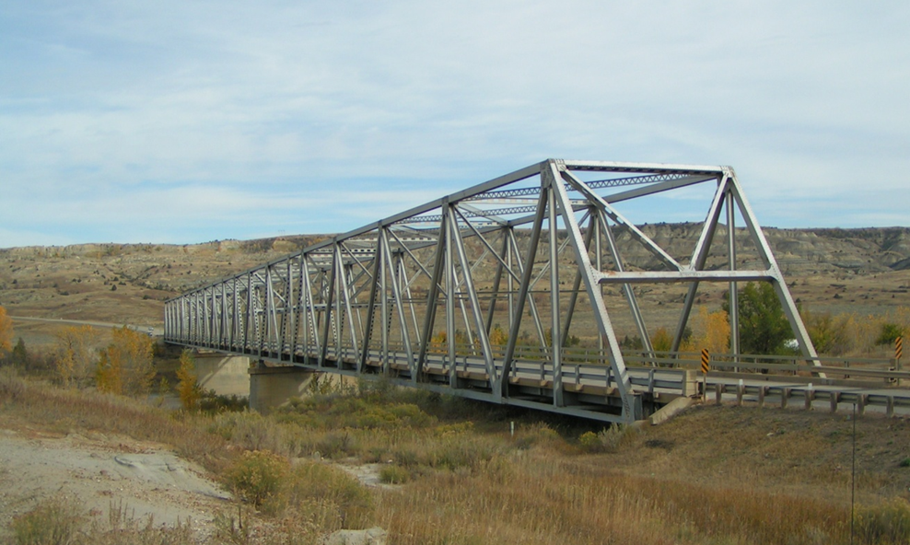
Long X Bridge
Based on monitoring and challenges, NDDOT will proceed to replace Long X Bridge when appropriate.

Slide 23
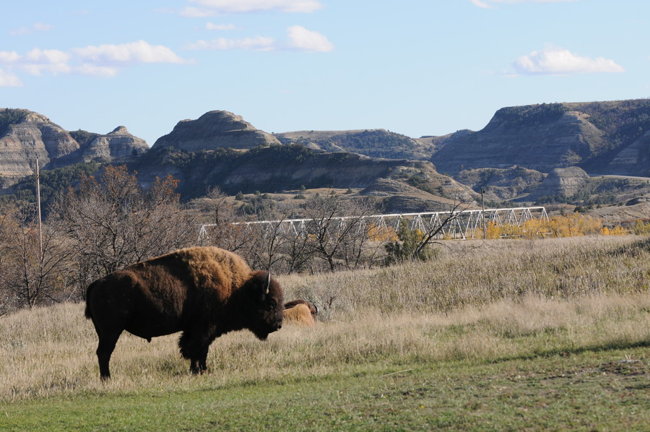
Challenges
Environmental and right-of-way challenges
May have difficulty reaching consensus with federal agencies on type of project that can be built and mitigation
Purpose and need statement

Slide 24
Traffic Modeling
NDDOT works in partnership with Upper Great Plains Transportation Institute to look at statewide needs and traffic modeling.

Slide 25
Transportation Planning
Proposed network of highway energy corridors

Slide 26
Safety
In 2012 there were 170 fatalities, compared to 148 fatalities in 2011.
As of November 23, 2013, there have been 133 fatalities, compared to 150 fatalities this time last year.
Top three contributing factors have been:
50% alcohol related
66% unrestrained
(no seat belts)
29% speed related
In 2012 nearly 40% of the traffic fatalities occurred on non state highways.

Slide 27
Partnership
We will continue to work together to provide a safe efficient transportation system.

Slide 28
Thank you!

